Slide 1

Executive Post Graduate Certificate in Cloud Computing and DevOps

Slide 2


Course: Cloud Computing
Lecture on: Deployment Models, Security and Future of Cloud Computing
Instructor: Chandrashekar Ramanathan

Slide 3
Brief Recap
1
Cloud Computing: Overview
2
Cloud Services: Types
3
Cloud Computing: Advantages and Disadvantages
Notes:
In our previous session, we covered an overview of cloud computing concepts, types of cloud services, and the advantages and disadvantages of cloud computing.
We used Google Cloud Platform (GCP) to illustrate these concepts and provide practical examples.

Slide 4
Today’s Agenda
1
Cloud Deployment Models: Types
2
Cloud Security and Compliance Practices
3
Emerging Trends and Future of Cloud Computing
Notes:
In today's session, we will take a closer look at Microsoft and use it as a case study to delve deeper into these cloud computing topics.
By examining Microsoft Azure, we will explore how another leading cloud provider approaches cloud deployment models, security and compliance, and the future of cloud computing.

Slide 5
Cloud Deployment Models
Cloud deployment models determine how cloud services are made available to users and how resources are managed and distributed
Public Cloud
Private Cloud
Hybrid Cloud
Cloud Deployment Models
Multi-cloud
Intercloud
Community Cloud
Each model grants users anytime, anywhere access to the files and applications that drive their business, but they differ in their approach to resource management, security and control

Slide 6
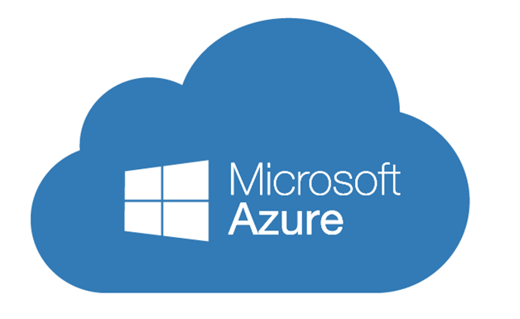
Public Cloud
Example: Microsoft Azure
Microsoft Azure offers a robust public cloud platform, providing services such as virtual machines, databases and AI services
Public cloud offerings from Azure include SaaS applications, individual virtual machines and enterprise-grade infrastructures

Slide 7
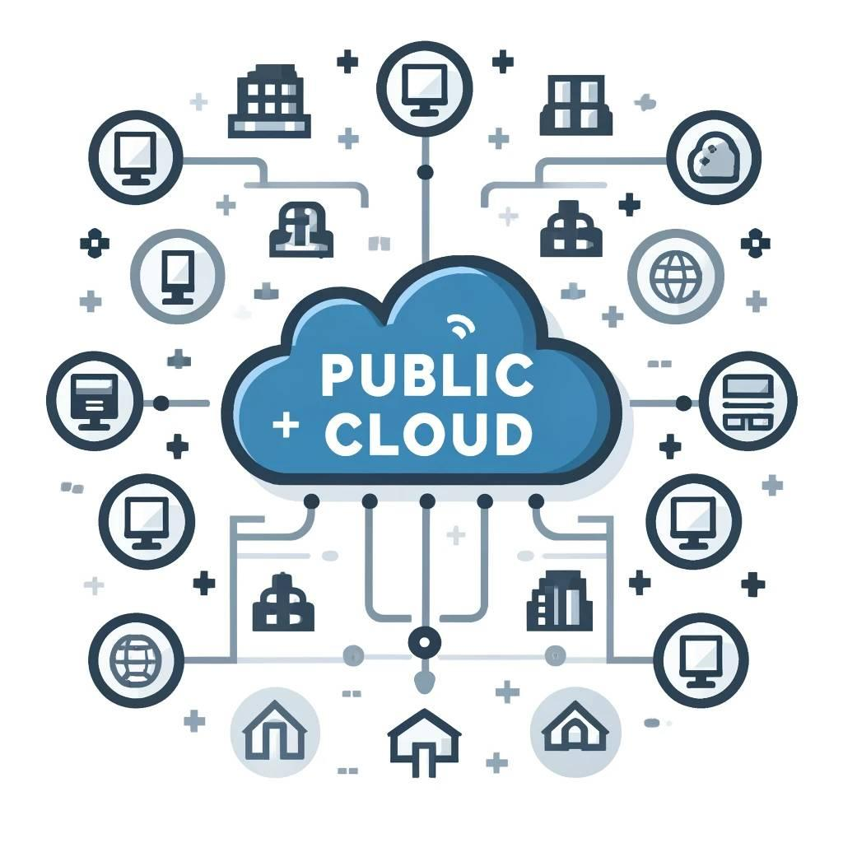
Public Cloud
Public clouds are hosted by cloud service providers and distributed over the open internet. They free customers from having to purchase, manage and maintain their own IT infrastructure
Multi-tenant environment: Resources are shared among many users
High performance and rapid access: Provided through high-bandwidth network connectivity

Slide 8

Private Cloud
Example: Microsoft Azure Stack
Microsoft Azure Stack allows organisations to deploy Azure services in their own data centre, creating a private cloud environment with dedicated resources
This setup provides a higher level of security and privacy by offering dedicated resources to the company

Slide 9

Private Cloud
Private clouds consist of computing resources dedicated exclusively to an organisation. They offer self-service, scalability and elasticity with added control and customisation
Higher security and privacy: Housed on private networks not accessible to public traffic; suitable for sectors such as government, healthcare and finance

Slide 10
Hybrid Cloud
Example: Microsoft Azure Hybrid Cloud Solutions
Microsoft Azure offers hybrid cloud solutions that enable integration between on-premises infrastructure and Azure
It allows organisations to run sensitive applications and services in a secure private cloud while hosting less sensitive, customer-facing endpoints in the public cloud

Slide 11
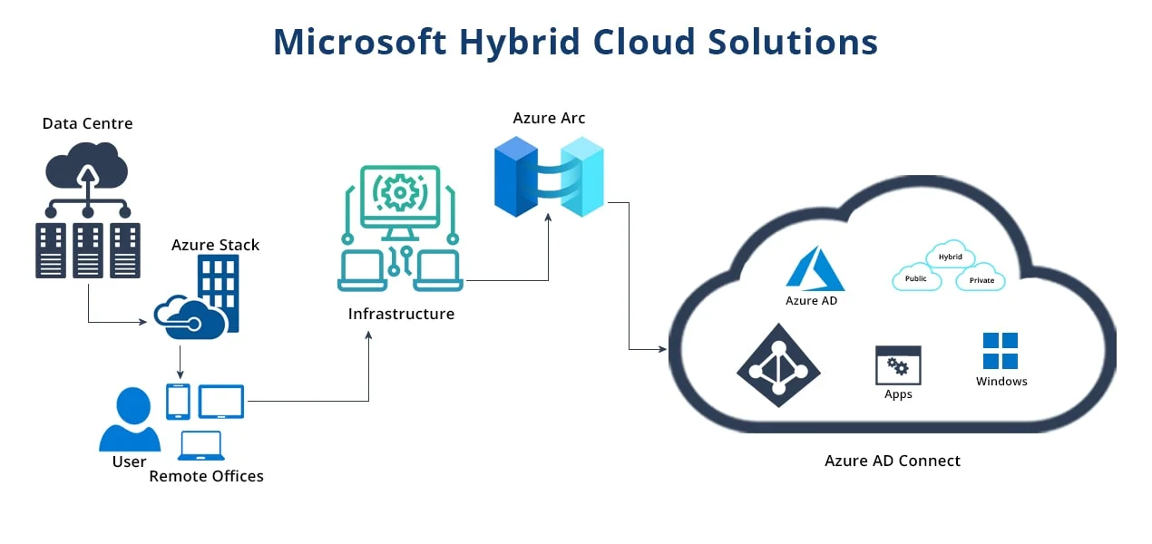
Hybrid Cloud

Slide 12
Hybrid Cloud
Hybrid clouds are a combination of private and public clouds, connected together with technology that enables data and applications to work together
This architecture offers a flexible, secure and cost-effective environment that supports the portability and automated deployment of the workload across multiple environments
Hybrid clouds are ideal for scenarios such as DevOps, where applications can be developed and tested in the public cloud and then moved to a private cloud for production based on business needs or security factors

Slide 13

Multi-Cloud
Example: Microsoft Azure Arc
Microsoft Azure Arc extends Azure management and services to other cloud environments such as AWS and Google Cloud, facilitating a multi-cloud strategy
This approach allows organisations to leverage the best services from multiple cloud providers

Slide 14
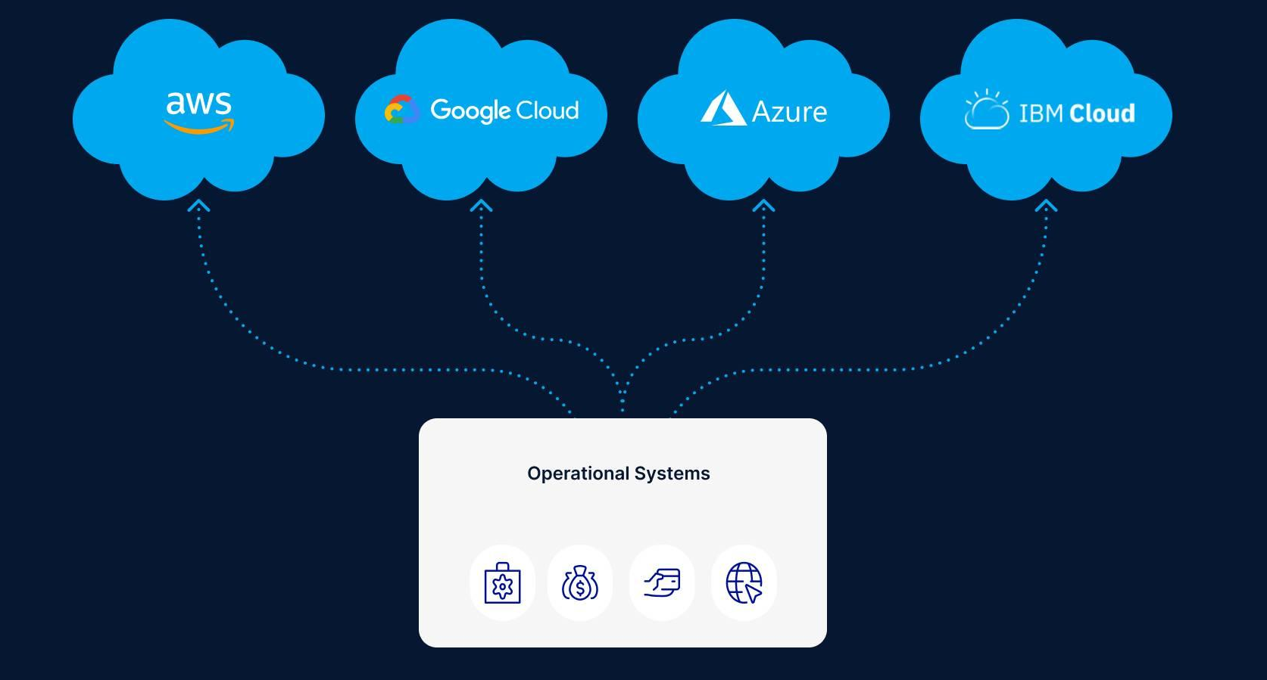
Multi Cloud

Slide 15
Multi Cloud
Multi-cloud strategies use the best services from multiple cloud providers to deploy a solution
A multi-cloud solution integrates IaaS, PaaS and SaaS in a tightly or loosely coupled architecture
This approach avoids vendor lock-in, provides more service options and fosters innovation
For example, a company might use Azure for its security features, AWS for its global reach with web hosting and IBM Cloud for its data analytics capabilities

Slide 16

Intercloud
Example: Microsoft Azure Intercloud Solutions
Azure supports intercloud connectivity through solutions such as Azure ExpressRoute, enabling secure connections between different cloud environments and on-premises infrastructure

Slide 17
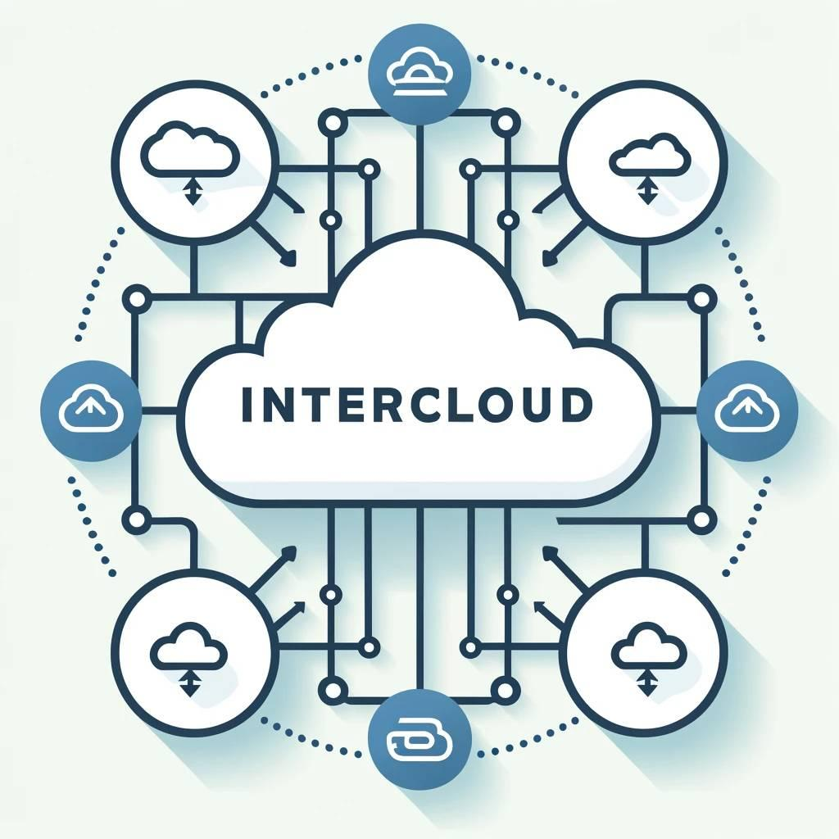
Intercloud
Intercloud is a cloud computing strategy that allows the active management of data across multiple cloud environments, with each service on a different cloud infrastructure
This approach is important for integrating data and analytics workflows across different services and clouds, providing extra value using different remote cloud environments and expert programs

Slide 18
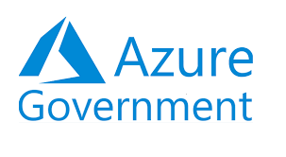
Community Cloud
Example: Microsoft Azure Government
Microsoft Azure Government provides a dedicated community cloud environment for US government agencies and their partners, exemplifying a community cloud

Slide 19
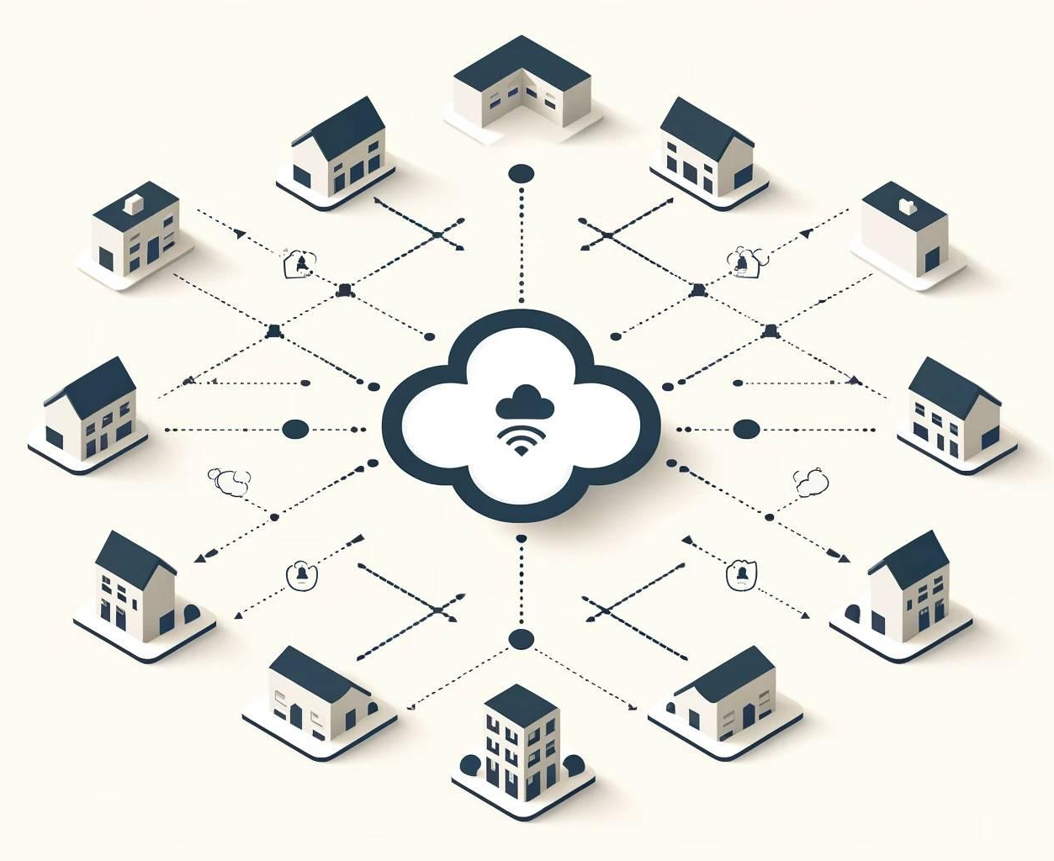
Community Cloud
Community clouds share resources and services based on common operational and regulatory requirements, addressing the needs of industries with stringent regulations, such as healthcare, finance and education
Community clouds offer more security than public clouds but are more cost-effective than private clouds, making them suitable for growing organisations within regulated sectors

Slide 20
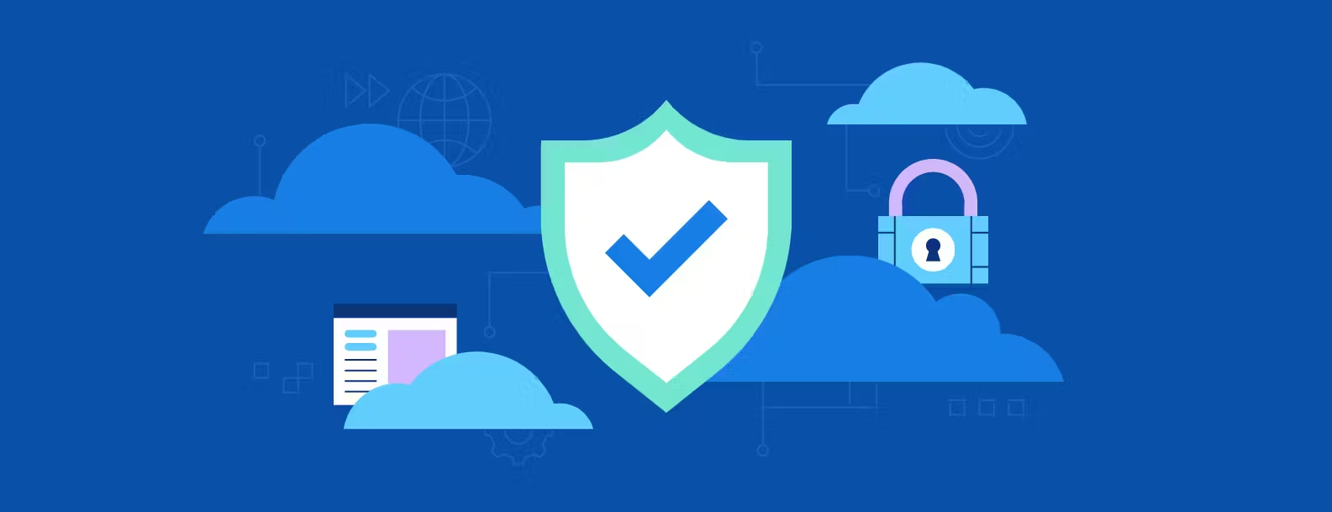
Cloud Security and Compliance
Traditionally, security concerns have been the primary obstacle for organisations considering cloud services. Maintaining cloud security demands different procedures and employee skill sets than in legacy IT environments

Slide 21
Shared Responsibility for Security
In Azure, Microsoft is responsible for securing the underlying cloud infrastructure, including physical data centres and networks. Customers are responsible for protecting their data, configuring network security and managing user access within their Azure environment
Clearly defining data ownership and security responsibilities is crucial

Slide 22

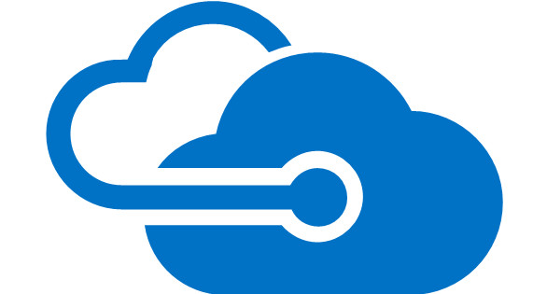

Data Encryption
Azure offers data encryption services such as Azure Disk Encryption, Azure Storage Service Encryption and Azure Key Vault for managing encryption keys and secrets
Data should be encrypted at rest, in transit and in use. Customers need to maintain complete control over security keys and hardware security modules to ensure data integrity and confidentiality

Slide 23
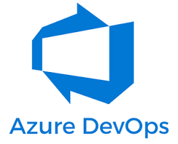
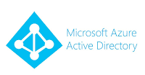
Collaborative Management
Azure DevOps and Azure Active Directory (AAD) facilitate collaborative management by providing integrated tools for secure code deployment, user authentication and access management
Proper communication and clear processes among IT, operations and security teams are crucial for seamless and secure cloud integrations
Collaborative management tools help streamline these processes and enhance overall security

Slide 24

Security and Compliance Monitoring
Azure Security Center provides continuous security assessment, advanced threat detection and security recommendations. Azure Policy helps organisations enforce compliance with regulatory standards
Understanding regulatory compliance standards and establishing active monitoring of all connected systems and cloud services are vital for maintaining data visibility and regulatory compliance

Slide 25
Emerging Trends and Future of Cloud Computing
In recent years, cloud computing has experienced significant advancements and transformations, reshaping the way organisations operate and individuals access digital resources
As technology continues to evolve, several key trends and innovations are driving the future of cloud computing. Understanding these trends is essential for staying competitive and leveraging the full potential of cloud technologies

Slide 26
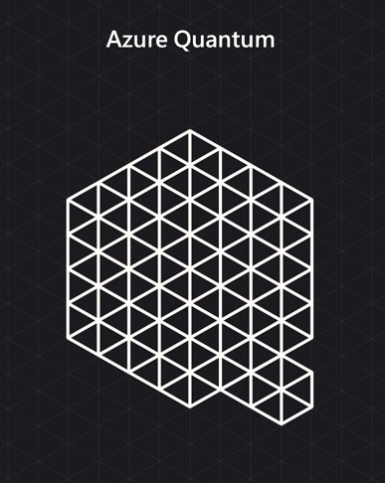
Current Trends in Cloud Computing
General Advancements in Technology
Microsoft Azure integrates the latest technological advancements, such as quantum computing capabilities with Azure Quantum
These advancements have led to the rapid adoption of cloud services, primarily because these technologies allow for more efficient use of resources and faster deployment of applications

Slide 27
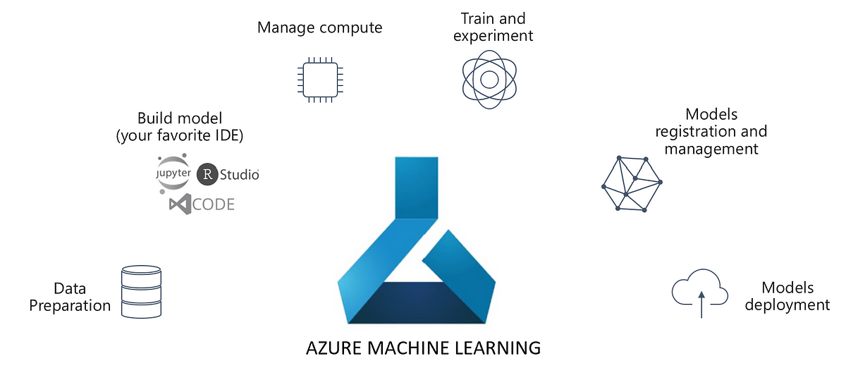
Current Trends in Cloud Computing
More Adoptions for AI and ML

Slide 28
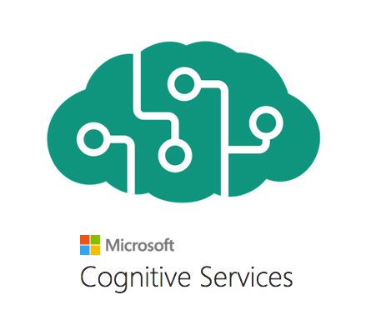
Current Trends in Cloud Computing
More Adoptions for AI and ML
Azure Machine Learning and Azure Cognitive Services provide powerful AI and ML platforms that require significant processing power and bandwidth, which Azure efficiently delivers
These platforms need a lot of processing power and data bandwidth. The cloud is the most cost-effective approach for these resources, allowing developers to make data-driven decisions and create intelligent applications

Slide 29
Current Trends in Cloud Computing
More Focus on Security Enhancements
Azure Security Center offers enhanced security features, including encryption, identity management, user authentication and compliance certifications
Cloud service providers are providing enhanced cloud security features. The integration of greater security measures, such as encryption and identity management, has made cloud computing more secure and trusted by businesses

Slide 30
Current Trends in Cloud Computing
Focus on Sustainability
Microsoft has committed to becoming carbon negative by 2030, investing in renewable energy sources and implementing energy-efficient technologies in their data centres
Data centres use immense amounts of energy. Companies are investing in renewable energy and energy-efficient technologies, making sustainability an essential corporate governance mandate

Slide 31
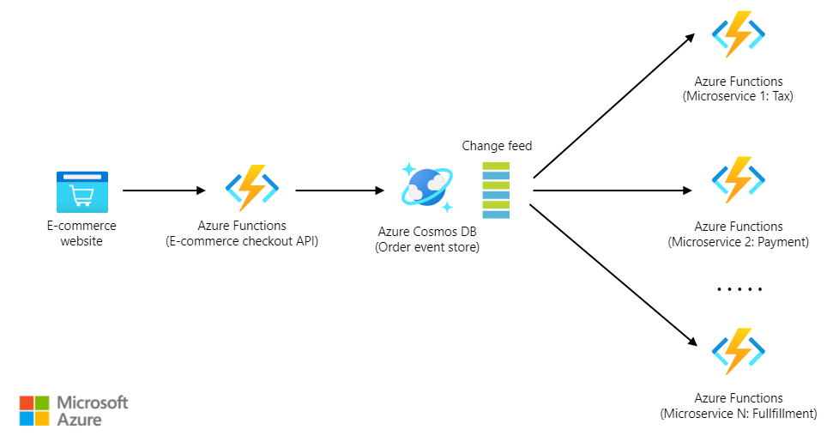
Innovations in Cloud Technology
Serverless Services
Azure Functions provides a serverless compute service that automatically scales and charges only for the resources used, without the need for dedicated VM management

Slide 32
Innovations in Cloud Technology
Serverless Services
Services run on demand without needing a dedicated VM. They feature automatic scaling and built-in high availability and follow a pay-for-value billing model
If a service is serverless, you typically do not need to pay attention to the underlying server; resources are allocated out of a pool maintained by the cloud provider

Slide 33
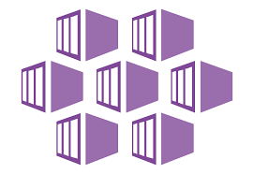
Innovations in Cloud Technology
Containers on Demand
Azure Kubernetes Service (AKS) allows for easy deployment and management of containerized applications
Containers are lightweight software units that package application code and dependencies, requiring fewer resources and costing less than VMs
Containers share the host machine’s operating system kernel. Containers can run on Docker Engine or a Kubernetes service

Slide 34
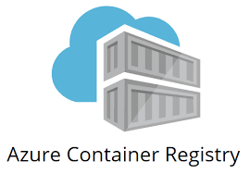
Innovations in Cloud Technology
Pre-Built Container Images
Azure Container Registry stores and manages container images, allowing for quick deployment and scalability of containerised applications
Docker containers and images enable rapid application deployment and scalability. Pre-built container images are vendor-agnostic and can quickly bring up full applications

Slide 35
Innovations in Cloud Technology
Cloud GPUs, TPUs and FPGAs
Azure provides specialised VM instances with GPUs, TPUs and FPGAs for high-performance computing tasks
Deep learning with large models and the large data sets needed for accurate training can often take much more than a week on clusters of CPUs. GPUs, TPUs and FPGAs can all significantly reduce the training time, and their availability in the cloud eases their use when needed

Slide 36
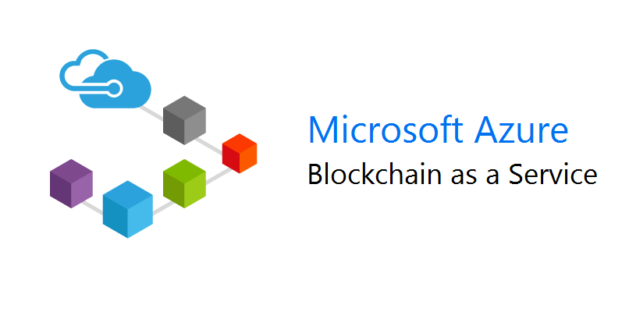
Future Outlook and Predictions for the Cloud Industry
Blockchain
Azure Blockchain Service enables the creation, management and governance of blockchain networks at scale
We expect a greater integration of blockchain technology with cloud computing. Blockchain as a Service (BaaS) platforms improve operational efficiency, security and transparency

Slide 37
Current Trends in Cloud Computing
Internet of Things (IoT)
Azure IoT Hub and Azure Digital Twins provide comprehensive IoT solutions for connecting, monitoring and managing billions of IoT assets
IoT is a network of interconnected physical devices that collect and share data. Integrating cloud computing with IoT advances data storage, processing, real-time analysis and AI/ML integration

Slide 38
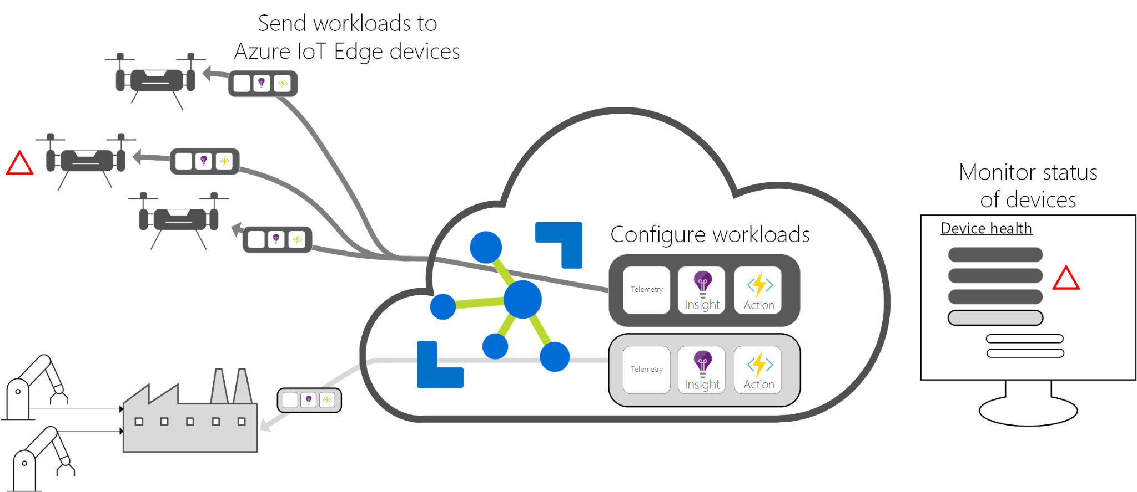
Current Trends in Cloud Computing
Edge Computing
Azure IoT Edge extends cloud intelligence and analytics to edge devices, reducing latency and bandwidth usage while enabling real-time data processing

Slide 39
Current Trends in Cloud Computing
Edge Computing
Edge computing processes data closer to its source rather than in a distant data centre. This approach reduces latency and optimises bandwidth, ensuring faster response times and efficient data management
  Reduced latency: Processing data directly where it is generated minimises latency and ensures faster response times
  Bandwidth optimisation: Local processing of data and transfer of only pertinent or condensed information to the cloud streamlines data transfer and maintains robust network connections

Slide 40
Summary and Key Takeaways
1
Cloud Deployment Models
Public cloud: Cost-effective, scalable and accessible resources managed by cloud service providers such as AWS, Google Cloud and Microsoft Azure
Private cloud: Dedicated resources for a single organisation, ensuring higher security and privacy
Hybrid cloud: Combines public and private clouds for flexible application and data deployment

Slide 41
Summary and Key Takeaways
1
Cloud Deployment Models
Multi-cloud: Uses services from multiple cloud providers to avoid vendor lock-in and enhance flexibility
Intercloud: Manages data across multiple cloud environments for integrated data and analytics workflows
Community Cloud: Shared infrastructure among organisations with common regulatory and operational requirements

Slide 42
Summary and Key Takeaways
2
Cloud Security and Compliance
Shared responsibility: Cloud providers secure the infrastructure, and customers protect their data
Data encryption: Essential for securing data at rest, in transit and in use
Collaborative management: Ensures secure cloud integrations through effective communication and clear processes
Security and compliance monitoring: Active monitoring of connected systems and cloud services to maintain data visibility and regulatory compliance

Slide 43
Summary and Key Takeaways
3
Emerging Trends and Future of Cloud Computing
Current trends: Rapid adoption of cloud services, increased use of AI and ML, enhanced cloud security and focus on sustainability
Innovations in cloud technology: Serverless services; containers on demand; pre-built container images; and cloud GPUs, TPUs and FPGAs
Future outlook and predictions: Greater integration of blockchain technology, advancements in IoT and increased adoption of edge computing

Slide 44
Questions and Discussions

Slide 45
#LifeKoKaroLift
Thank You!

